Slide 1
Dis 05:
Trees, Mutation, Nonlocal
TA: Anita Cu
anitacu5@berkeley.edu

Slide 2
Agenda
0 ) Administrivia
1 ) Trees
2 ) Mutation
3 ) Nonlocal

Slide 3
Administrivia
Maps due yesterday 2/28
Lab 05 due tonight 3/1
HW 4 due tonight 3/1

Slide 4
1
Trees

Slide 5
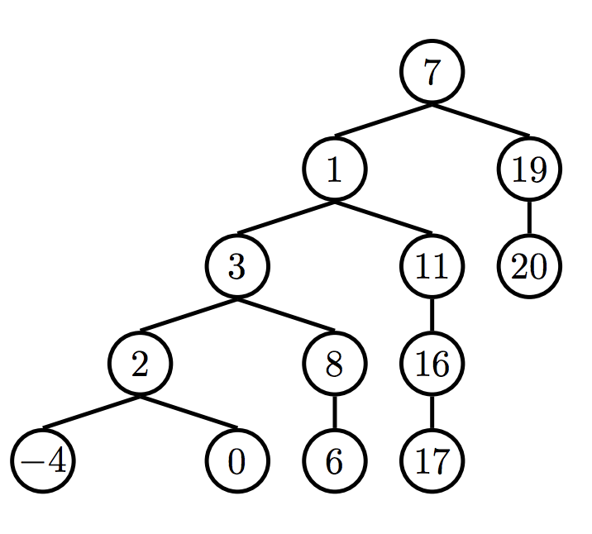
Trees
trees: recursive data structure

Slide 6
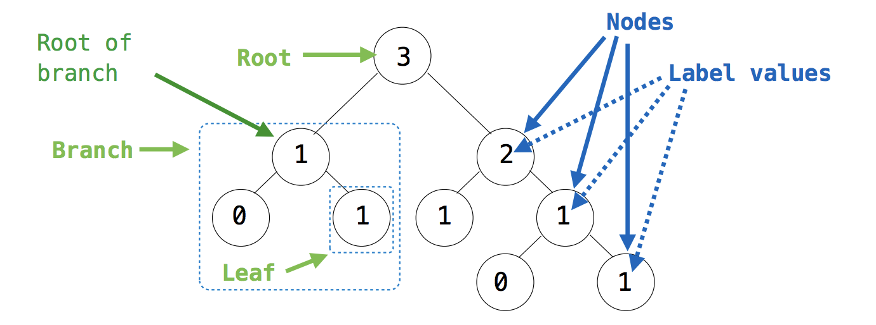
Trees
From Denero’s slides

Slide 7
Trees - Implementation
def tree(label, branches = []):
for branch in branches:
assert is_tree(branch)
return [label] + list(branches)

Slide 8
Trees - Implementation
Constructor
def tree(label, branches = []):
for branch in branches:
assert is_tree(branch)
return [label] + list(branches)

Slide 9
Trees - Implementation
Constructor
def tree(label, branches = []):
for branch in branches:
assert is_tree(branch)
return [label] + list(branches)
def label(tree):
return tree[0]

Slide 10
Trees - Implementation
Constructor
def tree(label, branches = []):
for branch in branches:
assert is_tree(branch)
return [label] + list(branches)
def label(tree):
return tree[0]
def branches(tree):
return tree[1:]

Slide 11
Trees - Implementation
Constructor
def tree(label, branches = []):
for branch in branches:
assert is_tree(branch)
return [label] + list(branches)
Selectors
def label(tree):
return tree[0]
def branches(tree):
return tree[1:]

Slide 12
Trees - Implementation
Constructor
def tree(label, branches = []):
for branch in branches:
assert is_tree(branch)
return [label] + list(branches)
Selectors
def label(tree):
return tree[0]
def branches(tree):
return tree[1:]
Function for your convenience
def is_leaf(tree):
return not branches(tree)

Slide 13
2
Mutable Lists
can we change the contents in our lists after we’ve created them?

Slide 14
Immutable Objects
immutable objects: cannot be changed once they are created!
Numbers, strings, tuples

Slide 15
Lists are Mutable!
> lst = [‘C’, ‘S’, 6]

Slide 16
Lists are Mutable!
> lst = [‘C’, ‘S’, 6]
Can modify list by adding an element to existing list

Slide 17
Lists are Mutable!
> lst = [‘C’, ‘S’, 6]
Can modify list by adding an element to existing list
Don’t want to create entire new list just to add one element.

Slide 18
Lists are Mutable!
> lst = [‘C’, ‘S’, 6]
> lst.append(1)

Slide 19
Lists are Mutable!
> lst = [‘C’, ‘S’, 6]
> lst.append(1)
List methods (e.g. append) are called via
dot notation, invoking the method by calling it on a particular list!

Slide 20
Lists are Mutable!
> lst = [‘C’, ‘S’, 6]
> lst.append(1)
> lst

Slide 21
Lists are Mutable!
> lst = [‘C’, ‘S’, 6]
> lst.append(1)
> lst
[‘C’, ‘S’, 6, 1]

Slide 22
Lists are Mutable!
> lst = [‘C’, ‘S’, 6]
> lst.append(1)
> lst
[‘C’, ‘S’, 6, 1]
lst.append(elem)
lst += [elem]
both ways add elem to end of lst!

Slide 23
Lists are Mutable!
> lst = [‘C’, ‘S’, 6]
> lst.append(1)
> lst
[‘C’, ‘S’, 6, 1]
> lst += [‘A’]
lst.append(elem)
lst += [elem]
both ways add elem to end of lst!

Slide 24
Lists are Mutable!
> lst = [‘C’, ‘S’, 6]
> lst.append(1)
> lst
[‘C’, ‘S’, 6, 1]
> lst += [‘A’]
> lst
lst.append(elem)
lst += [elem]
both ways add elem to end of lst!

Slide 25
Lists are Mutable!
> lst = [‘C’, ‘S’, 6]
> lst.append(1)
> lst
[‘C’, ‘S’, 6, 1]
> lst += [‘A’]
> lst
[‘C’, ‘S’, 6, 1, ‘A’]
lst.append(elem)
lst += [elem]
both ways add elem to end of lst!

Slide 26
Watch Out!
lst += [elem]
# adds elem to end of lst
IS NOT THE SAME AS
lst = lst + [elem]
# creates a copy of lst with a new pointer and adds elem to this new pointer
More explanation here:
https://stackoverflow.com/questions/2347265/why-does-behave-unexpectedly-on-lists

Slide 27
More Useful List Methods
insert(i, elem)
inserts elem at index i by shifting all elements after index i to the right to make space

Slide 28
More Useful List Methods
insert(i, elem)
inserts elem at index i by shifting all elements after index i to the right to make space
remove(elem)
removes first occurence of elem in the list
if elem does not appear in the list, throws an error

Slide 29
More Useful List Methods
insert(i, elem)
inserts elem at index i by shifting all elements after index i to the right to make space
remove(elem)
removes first occurence of elem in the list
if elem does not appear in the list, throws an error
pop(i)
removes and returns the element that occurs at index i

Slide 30
More Useful List Methods
insert(i, elem)
inserts elem at index i by shifting all elements after index i to the right to make space
remove(elem)
removes first occurence of elem in the list
if elem does not appear in the list, throws an error
pop(i)
removes and returns the element that occurs at index i
extend(lst)
Extends current list by concatenating it with lst

Slide 31
Lists are Mutable!
> lst
[‘C’, ‘S’, 6, 1, ‘A’]

Slide 32
Lists are Mutable!
> lst
[‘C’, ‘S’, 6, 1, ‘A’]
> lst[4] = ‘B’

Slide 33
Lists are Mutable!
> lst
[‘C’, ‘S’, 6, 1, ‘A’]
> lst[4] = ‘B’
> lst
[‘C’, ‘S’, 6, 1, ‘B’]

Slide 34
3
Nonlocal

Slide 35
Nonlocal
Say we have a higher order function
> def stepper(num):
def inc():
num = num + 1
return num
return inc

Slide 36
Nonlocal
Say we have a higher order function
> def stepper(num):
def inc():
num = num + 1
return num
return inc
> result = stepper(5)()

Slide 37
Nonlocal
Say we have a higher order function
> def stepper(num):
def inc():
num = num + 1
return num
return inc
> result = stepper(5)()
UnboundLocalError: local variable 'num' referenced before assignment

Slide 38
Nonlocal
Say we have a higher order function
> def stepper(num):
def inc():
num = num + 1
return num
return inc
> result = stepper(5)()
UnboundLocalError: local variable 'num' referenced before assignment
Right now, we can only access variables of parent frames but cannot modify (re-assign) values to these variables!

Slide 39
Nonlocal
Say we have a higher order function
> def stepper(num):
def inc():
nonlocal num
num = num + 1
return num
return inc
> result = stepper(5)()
Here’s where nonlocal comes in handy!
Now we can modify these variables!

Slide 40
Nonlocal
Say we have a higher order function
> def stepper(num):
def inc():
nonlocal num
num = num + 1
return num
return inc
> result = stepper(5)()
> result
Here’s where nonlocal comes in handy!
Now we can modify these variables!

Slide 41
Nonlocal
Say we have a higher order function
> def stepper(num):
def inc():
nonlocal num
num = num + 1
return num
return inc
> result = stepper(5)()
> result
6
Here’s where nonlocal comes in handy!
Now we can modify these variables!

Slide 42
Nonlocal
Say we have a higher order function
> def stepper(num):
def inc():
nonlocal num
num = num + 1
return num
return inc
> result = stepper(5)()
> result
6
2 rules:
Cannot use nonlocal to modify variables in the GLOBAL frame.

Slide 43
Nonlocal
Say we have a higher order function
> def stepper(num):
def inc():
nonlocal num
num = num + 1
return num
return inc
> result = stepper(5)()
> result
6
2 rules:
Cannot use nonlocal to modify variables in the GLOBAL frame.
Cannot use nonlocal for local variables in the current frame ⇒ this means we cannot have local and nonlocal variables with the same name.

Slide 44
Nonlocal
Say we have a higher order function
> def stepper(num):
def inc():
nonlocal num
num = num + 1
return num
return inc
> result = stepper(5)()
> result
6
VARIABLE LOOKUP
If we see a variable is nonlocal, we’ll lookup the variable in the parent frame of our current frame.

Slide 45
Nonlocal
Say we have a higher order function
> def stepper(num):
def inc():
nonlocal num
num = num + 1
return num
return inc
> result = stepper(5)()
> result
6
VARIABLE LOOKUP
If we see a variable is nonlocal, we’ll lookup the variable in the parent frame of our current frame.
If it’s not there, keep going up the chains of parent frames (as long as it’s not the global frame).

Slide 46
Nonlocal
Say we have a higher order function
> def stepper(num):
def inc():
nonlocal num
num = num + 1
return num
return inc
> result = stepper(5)()
> result
6
VARIABLE LOOKUP
If we see a variable is nonlocal, we’ll lookup the variable in the parent frame of our current frame.
If it’s not there, keep going up the chains of parent frames (as long as it’s not the global frame).
Once we’ve found the variable, we can now modify the variable in the parent frame found.

Slide 47
Nonlocal
> def stepper(num):
def inc():
nonlocal num
num = num + 1
return num
return inc
> f = stepper(5)

Slide 48
Nonlocal
> def stepper(num):
def inc():
nonlocal num
num = num + 1
return num
return inc
> f = stepper(5)
> f()

Slide 49
Nonlocal
> def stepper(num):
def inc():
nonlocal num
num = num + 1
return num
return inc
> f = stepper(5)
> f()
6

Slide 50
Nonlocal
> def stepper(num):
def inc():
nonlocal num
num = num + 1
return num
return inc
> f = stepper(5)
> f()
6
> f()

Slide 51
Nonlocal
> def stepper(num):
def inc():
nonlocal num
num = num + 1
return num
return inc
> f = stepper(5)
> f()
6
> f()
7

Slide 52
Nonlocal
> def stepper(num):
def inc():
nonlocal num
num = num + 1
return num
return inc
> f = stepper(5)
> f()
6
> f()
7
> f()
8

Slide 53
Nonlocal
> def stepper(num):
def inc():
nonlocal num
num = num + 1
return num
return inc
> f = stepper(5)
> f()
6
> f()
7
> f()
8
> f2 = stepper(5)

Slide 54
Nonlocal
> def stepper(num):
def inc():
nonlocal num
num = num + 1
return num
return inc
> f = stepper(5)
> f()
6
> f()
7
> f()
8
> f2 = stepper(5)
> f2()

Slide 55
Nonlocal
> def stepper(num):
def inc():
nonlocal num
num = num + 1
return num
return inc
> f = stepper(5)
> f()
6
> f()
7
> f()
8
> f2 = stepper(5)
> f2()
6

Slide 56
Nonlocal
> def stepper(num):
def inc():
nonlocal num
num = num + 1
return num
return inc
> f = stepper(5)
> f()
6
> f()
7
> f()
8
> f2 = stepper(5)
> f2()
6
> f2()
7

Slide 57
Nonlocal
nonlocal is useful for maintaining state across different calls to the same function
> def stepper(num):
def inc():
nonlocal num
num = num + 1
return num
return inc
> f = stepper(5)
> f()
6
> f()
7
> f()
8
> f2 = stepper(5)
> f2()
6
> f2()
7

